Slide 1
Cost Of Attendance
Part 3
College Prep
Mr. Gordon
jgordon@bisdtx.org

Slide 2
Upcoming Events
Thurs. Oct. 14th 6PM CRCA in BISD Homecoming Parade
Sat. Oct. 16th 8AM-2PM 11th Grade PSAT
Fri. Oct. 29th 4:10-9:00 PM CRCA Lock-In $5 Please pay Mr. Gordon Price includes 2 slices of pizza and chips, open gym, games, etc.
hi

Slide 3

Cost of Tuition
Some students choose to continue their education at ACC once they graduate from CRCA for two reasons:
They want to finish their Associate degree
The degree they want is offered at ACC
hi

Slide 4
Cost of Tuition
We have discussed in-state vs. out-of-state tuition, there is one more difference that only applies to community colleges like ACC
in-district vs. out-of-district.
Instead of being based on what state you live in, this is based on what local tax district you live in.
Currently, Bastrop and Cedar Creek are considered out-of-district for ACC, unlike Elgin, Austin, and many surrounding cities.
hi

Slide 5
In-District vs. Out-of-District
This means for a student from Austin to take the Drama class, they would pay $255.
For a student from Bastrop to take the same class,
they would pay $858.
ACC Tuition Table Link
https://www.austincc.edu/students/tuition-and-payments/tuition-table
hi

Slide 6
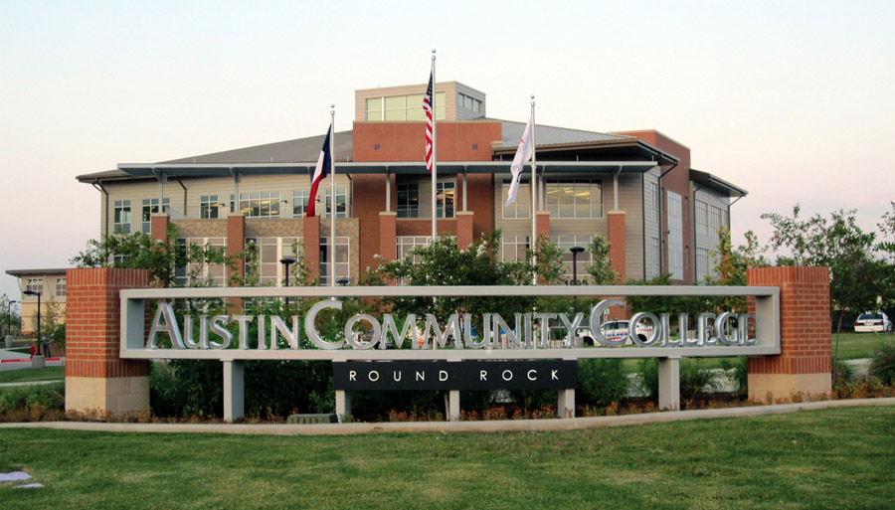
In-District vs. Out-of-District
For one class, this may not make much difference, but for a lot of classes, this can easily add up to thousands of dollars.
For this reason, many times I will advise students continuing on at ACC to consider moving to an in-district city to receive in-district tuition.
hi

Slide 7
Today’s College Prep Assignment
In the comments section of today’s College Prep,
answer the following question:
Is a hot dog a sandwich?
hi

